Slide 1




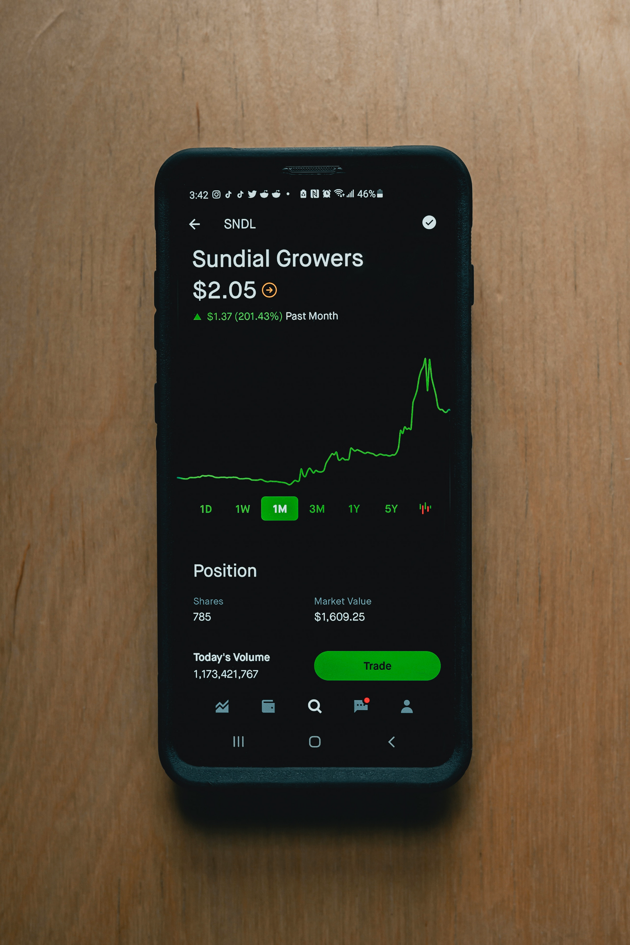

Your
Fintech
presentation
Let's go →

Slide 2




How to Use This Presentation
Export this design from Canva as a PowerPoint template. Open the design in Canva. This will provide you with all the fonts used and elements used in this presentation as listed on page 21. Learn more on slide 3.
Export this design from Canva as a GoogleSlide template. This will provide you with all the fonts used and elements used in this presentation as listed on page 21. Learn more on slide 4.
Click on the "Canva" button under this presentation preview. Start editing your presentation. You need to sign in to your Canva account.
Canva
PowerPoint
Google Slides

Slide 3
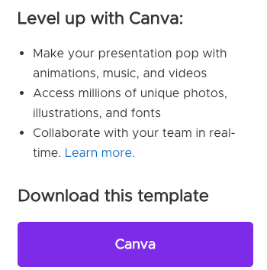
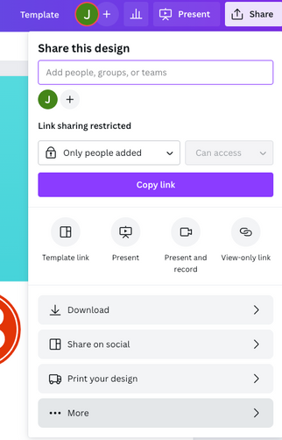
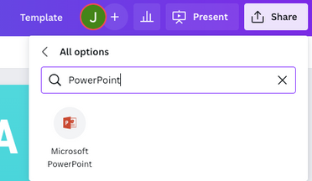
Download this presentation as a Powerpoint template in 3 steps
1
2
3
Click on the "Canva" button next to this presentation. Start editing your presentation. You may need to sign in to your Canva account.
Click on the "Share" button on the top right corner in Canva and click on "More" at the bottom of the menu.
Enter "PowerPoint" in the search bar and click on the PowerPoint icon to download.

Slide 4
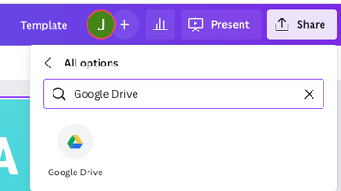
Use this presentation as a Google Slide template in 3 steps
1
2
3
Click on the "Canva" button next to this presentation. Start editing your presentation. You may need to sign in to your Canva account.
Click on the "Share" button on the top right corner in Canva and click on "More" at the bottom of the menu.
Enter "Google Drive" in the search bar and click on the Google Drive icon to add this design as a Google slide in your G Drive. It will ask you to link your Google account to Canva the first time.

Slide 5


Table of Contents
1
2
3
Introduction
Our Process
About Us
Elaborate on what you want to discuss.
Elaborate on what you want to discuss.
Elaborate on what you want to discuss.

Slide 6



1
Introduction
Elaborate on what you want to discuss.
Press here →

Slide 7

Welcome
to Presentation
I'm Rain, and I'll be sharing with you my beautiful ideas.
Follow to learn more:
www.reallygreatsite.com

Slide 8




Our Company
Briefly elaborate on what you want to discuss.
Who we are?
Briefly elaborate on what you want to discuss.
What we do?

Slide 9

Timeline
2020
2018
The startup secures seed funding from a group of angel investors and begins to expand its team and product offerings, including the launch of a robo-advisory platform that uses artificial intelligence to provide personalized investment advice to users.
2023
2015
After conducting extensive market research, the startup launches its first product, a mobile investment platform that allows users to invest in a diversified portfolio of stocks and bonds with just a few clicks.
The startup raises a Series A round of funding from a leading venture capital firm and scales its operations to reach a wider audience, achieving significant growth in user adoption and assets under management.
A group of financial and technology experts come together to create a new startup focused on developing innovative solutions to simplify the investment process for retail investors.
Add a main point here
Add a main point here
Add a main point here
Add a main point here

Slide 10


2
Our process
Elaborate on what you want to discuss.
Press here →

Slide 11

Our Services
A mobile app that allows users to easily transfer funds to other users or make payments online without the need for traditional banking services.
Personalized investment portfolios tailored to the user's financial goals, risk tolerance, and investment preferences.
A digital wallet that enables users to store and manage various types of currencies and cryptocurrencies in one place.
Real-time fraud detection and prevention technology that ensures the security and safety of transactions and user data.
Service Two
Service Four
Service Three
Service One

Slide 12


Your Project
Presentations are communication tools that can be used as demonstrations, lectures, speeches, reports, and more. It is mostly presented before an audience. It serves a variety of purposes, making presentations powerful tools for convincing and teaching.
2023
Role: Write your role here

Slide 13
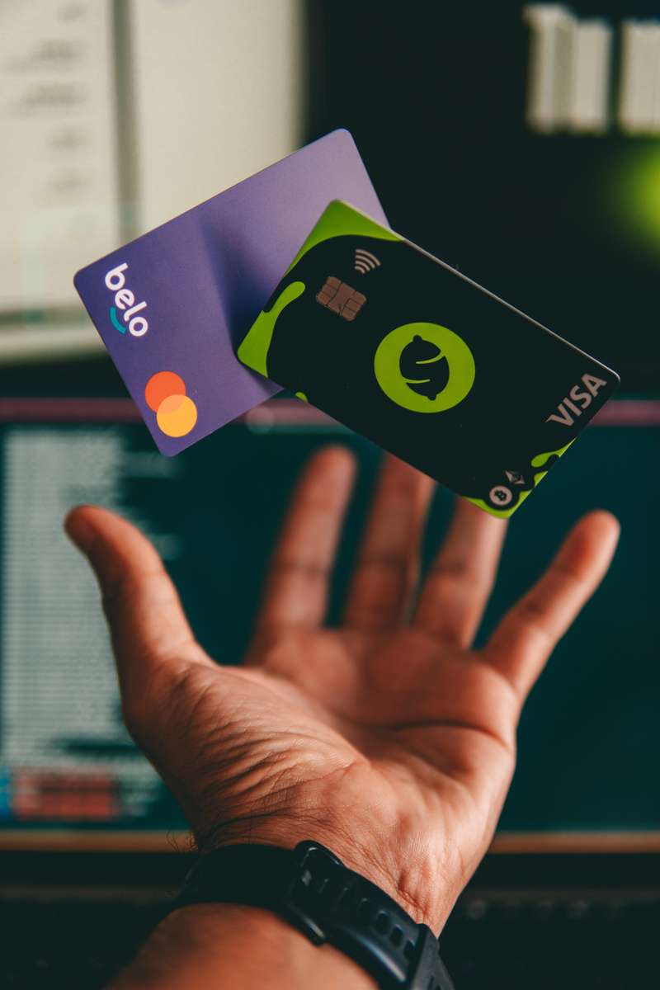
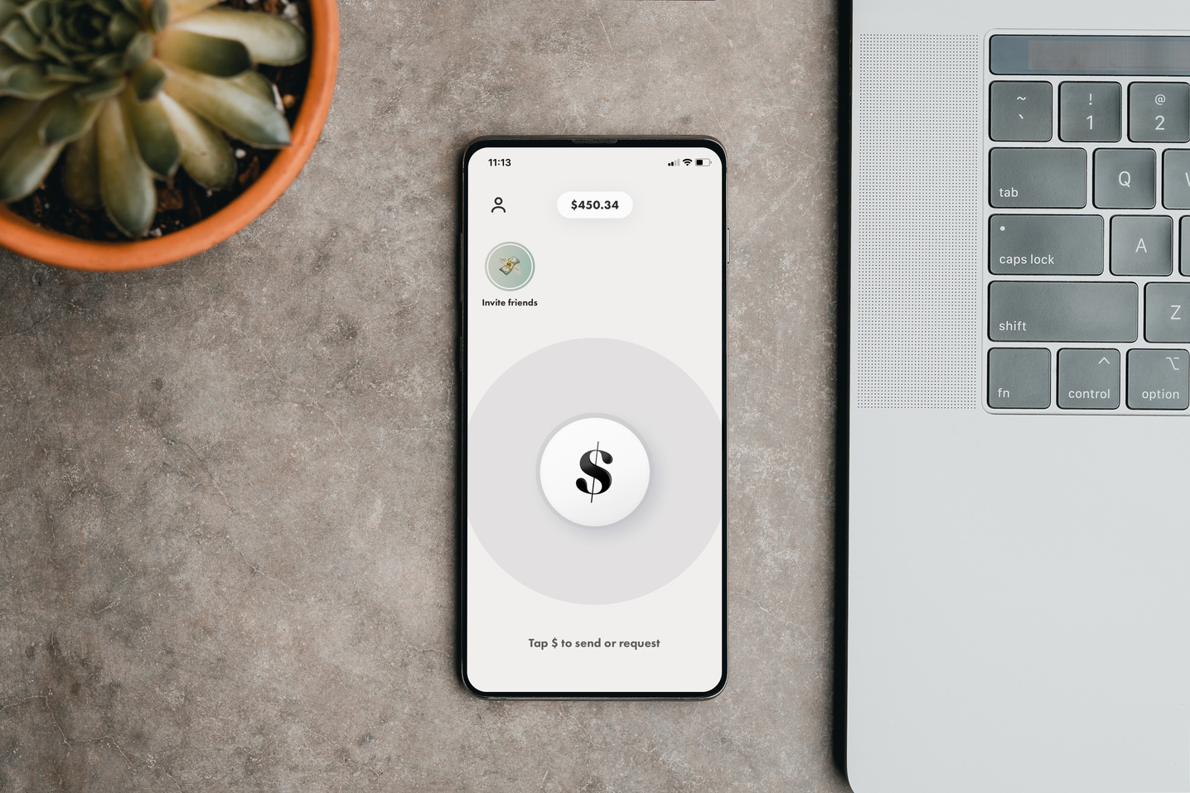



Image Gallery
What can you say about your projects? Share it here!

Slide 14
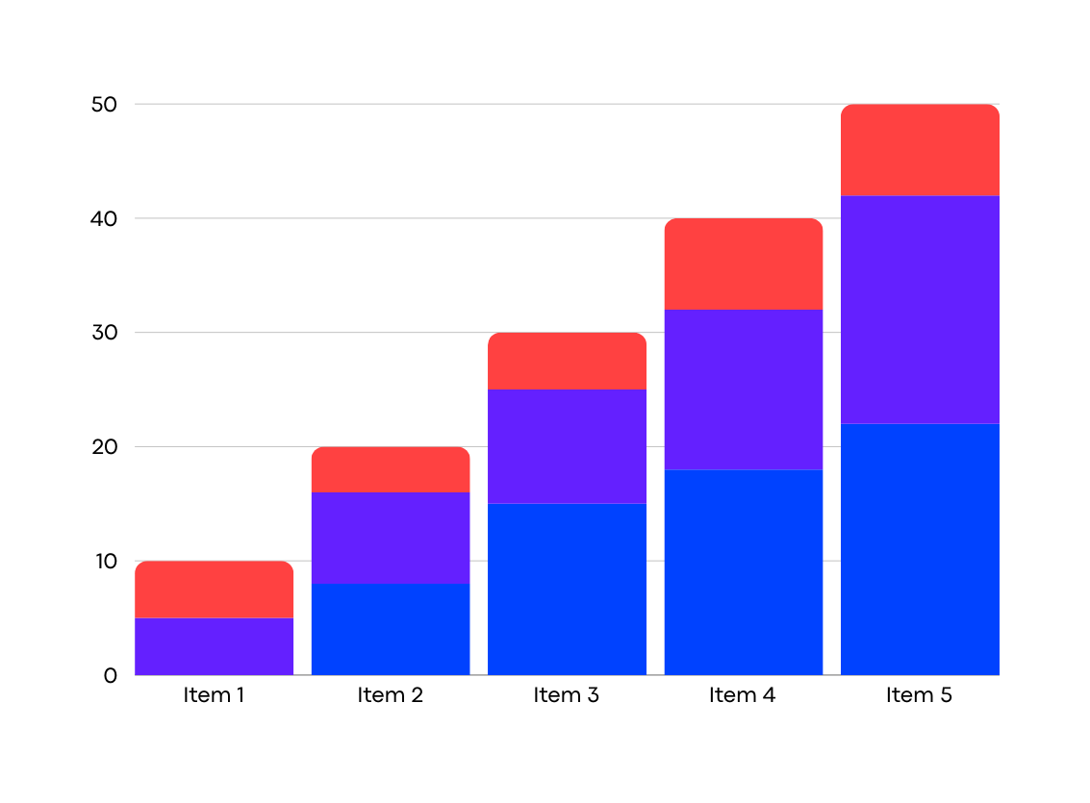
Analysis
Elaborate on the
featured statistic.

Slide 15
Target
Continuously innovate and improve products and services based on user feedback, market trends, and emerging technologies to stay competitive and relevant in the rapidly evolving fintech landscape.
Build partnerships with established financial institutions, payment processors, and other key players in the industry to leverage their expertise, resources, and customer base.
Establish a clear business plan and identify the target market and customer needs to ensure that the startup's products and services meet those needs.
Implement robust security and compliance measures to ensure that the startup complies with regulations and protects user data and funds.
Develop a user-friendly and intuitive platform that is easily accessible through various devices and channels.
Step 1
Step 2
Step 3
Step 4
Step 5

Slide 16
SWOT
Innovative technology that sets it apart from traditional financial institutions.
Agile and flexible organizational structure that allows for quick decision-making and adaptation to market changes.
Strong team with expertise in both technology and finance.
Strong competition from established players and other startups.
Increasing regulatory scrutiny and compliance requirements.
Rapidly evolving technological landscape may require significant investment to keep up.
Limited brand recognition and customer trust.
Limited financial resources compared to established financial institutions.
Dependence on third-party providers for some key services.
Growing demand for digital financial services.
Access to new customer segments through strategic partnerships and collaborations.
Expansion into new markets and geographies.
Strengths
Weaknesses
Opportunities
Threats

Slide 17
Table
Table 1 | Table 2 | Table 3 | Table 4
42 | 49 | 74 | 12
89 | 166 | 196 | 432
275 | 395 | 397 | 653
402 | 427 | 487 | 764
654 | 876 | 895 | 1368
Table title

Slide 18

Statistics
2 out
of 5
12
millions
95%
Elaborate on the featured statistic.
Elaborate on the featured statistic.
Elaborate on the featured statistic.

Slide 19
Pricing Page
$300
$70
$20
All features from monthly and weekly plans
Advanced investment tracking and analysis
Personalized investment recommendations
Tax planning tools
Priority customer support
Access to financial advisor or planner
All features from weekly plan
Investment tracking and analysis
Credit score monitoring
Customizable budget categories
Additional customer support via chat or phone
Option to link more financial accounts
Basic budgeting tools
Automated transaction categorization
Bill payment reminders
Savings goal tracking
Mobile app access
Customer support via emai.
Weekly
Monthly
Yearly

Slide 20

A picture is worth a thousand words

Slide 21


3
About us
Elaborate on what you want to discuss.
Press here →

Slide 22

Our History
In 2012, John Doe and Jane Smith founded a fintech startup with the goal of revolutionizing how individuals manage their personal finances. The company initially focused on developing a mobile app that allowed users to easily track and categorize their spending, and eventually expanded its offerings to include investment management, digital banking, and cryptocurrency trading. As of 2021, the startup has raised over $100 million in funding and has over 5 million users worldwide.
How it started

Slide 23




Our team
Head of Product Management
Director of Risk and Compliance
Chief Technology Officer
Chief Financial Officer
David Kim
Sarah Nguyen
James Johnson
Anna Lee
Elaborate on what you want to discuss.

Slide 24

Our Founder
Kim Bok-soon is a visionary entrepreneur and the founder of a fintech startup. She is known for her innovative approach to financial technology and her ability to identify and capitalize on emerging market trends.
With a background in finance and a passion for technology, Kim Bok-soon founded her startup with the goal of transforming the financial industry. She recognized that traditional financial institutions were not meeting the needs of modern consumers and saw an opportunity to create a more user-friendly and accessible financial platform.
Through her leadership and strategic vision, Kim Bok-soon has guided her startup to success, attracting significant investment and expanding its user base. She continues to drive innovation within the fintech industry and inspire other entrepreneurs to pursue their own vision of financial transformation.
Founder
Kim Bok-soon

Slide 25



Our Partners
Company
Company
Company
Elaborate on what you want to discuss.
Elaborate on what you want to discuss.
Elaborate on what you want to discuss.

Slide 26
Awards
Elaborate on what you want to discuss.
Elaborate on what you want to discuss.
Elaborate on what you want to discuss.
Elaborate on what you want to discuss.
Award 1
Award 2
Award 3
Award 4

Slide 27

Write an original statement or inspiring quote
— Include a credit, citation, or supporting message
Quote

Slide 28
Contact Us
123 Anywhere St., Any City,ST 12345
@reallygreatsite
123-456-7890
www.reallygreatsite.com
hello@reallygreatsite.com

Slide 29


Credits
This presentation template is free for everyone to use thanks to the following:
SlidesCarnival for the presentation template
Pexels for the photos
Happy designing!

Slide 30


Fonts In this Presentation
This presentation template uses the following free fonts:
Titles: Codec Pro ExtraBold
Headers: Codec Pro ExtraBold
Body Copy: Libre Baskerville (italic)
You can find these fonts online too. Happy designing!

Slide 31
Resource
Page
Use these design resources in your Canva Presentation.
Don't forget to delete this page before presenting.
Happy designing!

Slide 32


Free templates for all your presentation needs
For PowerPoint, Google Slides, and Canva
100% free for personal or commercial use
Ready to use, professional, and customizable
Blow your audience away with attractive visuals

